Slide 1
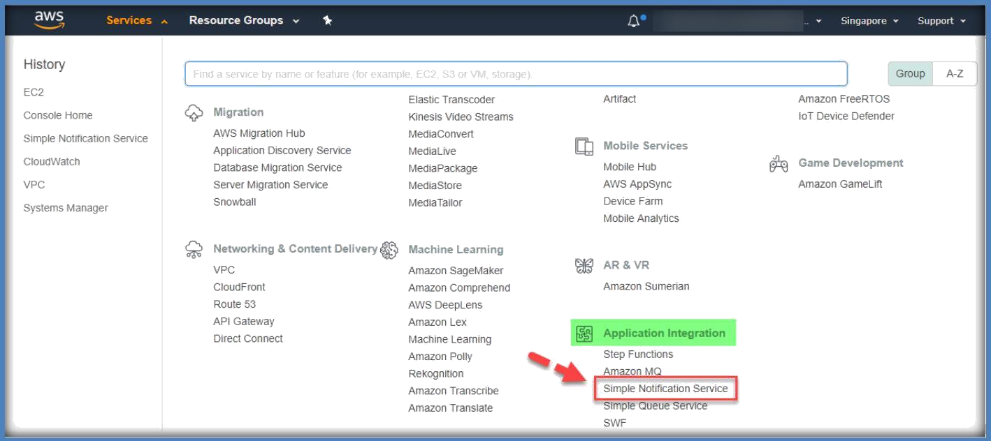
15. SIMPLE NOTIFICATION SERVICE
Amazon Simple Notification Service or SNS provides a simple way to notify applications or people from the cloud by creating topics and using a publish subscribe protocol.
SNS allows you to publish messages from within an application or directly from the console, and immediately deliver those via several protocols.
These messages are published to a centralized topic. Then, subscribers to this topic receive the messages.
It is typically used in cases, or you want the same single message to be sent to many subscribers.
One very basic but also quite conic example is alerting your operations team of an issue in your production system.
You can monitor your system components using CloudWatch and set up an alarm to be raised based on some event.
After logged in to AWS, click on Simple Notification Service under Application Integration section on AWS console page.

Slide 2
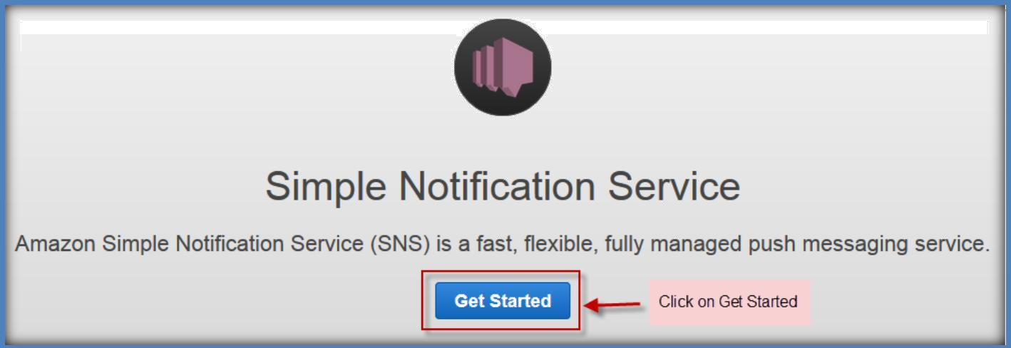
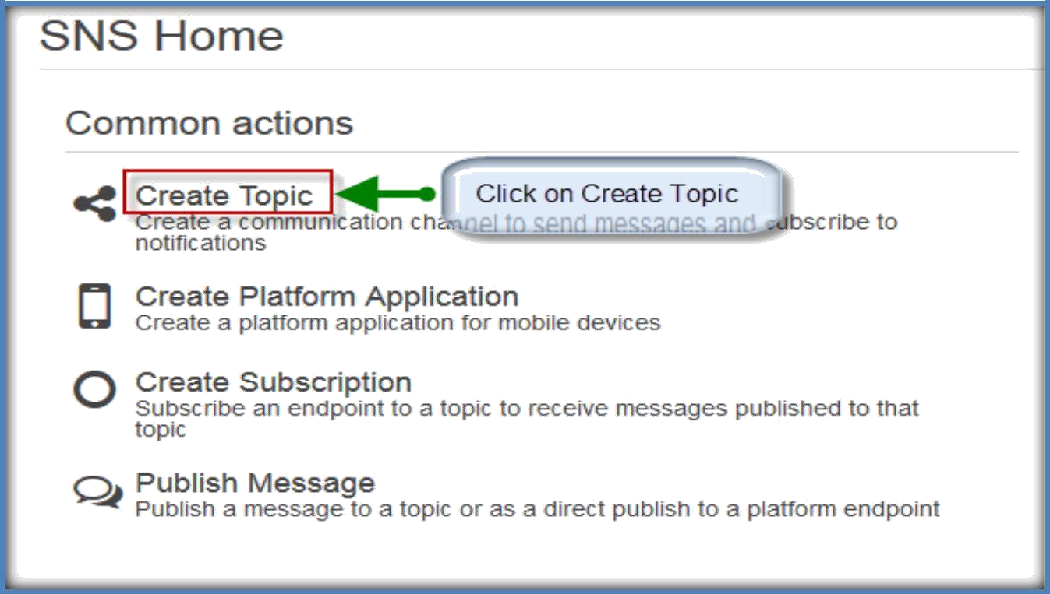
In the next page, click on Get Started to start using SNS.
In next window, click on
Create Topic to create a new one.
In the next window, specify a name for new topic, and add a display name then click on Create Topic.

Slide 3
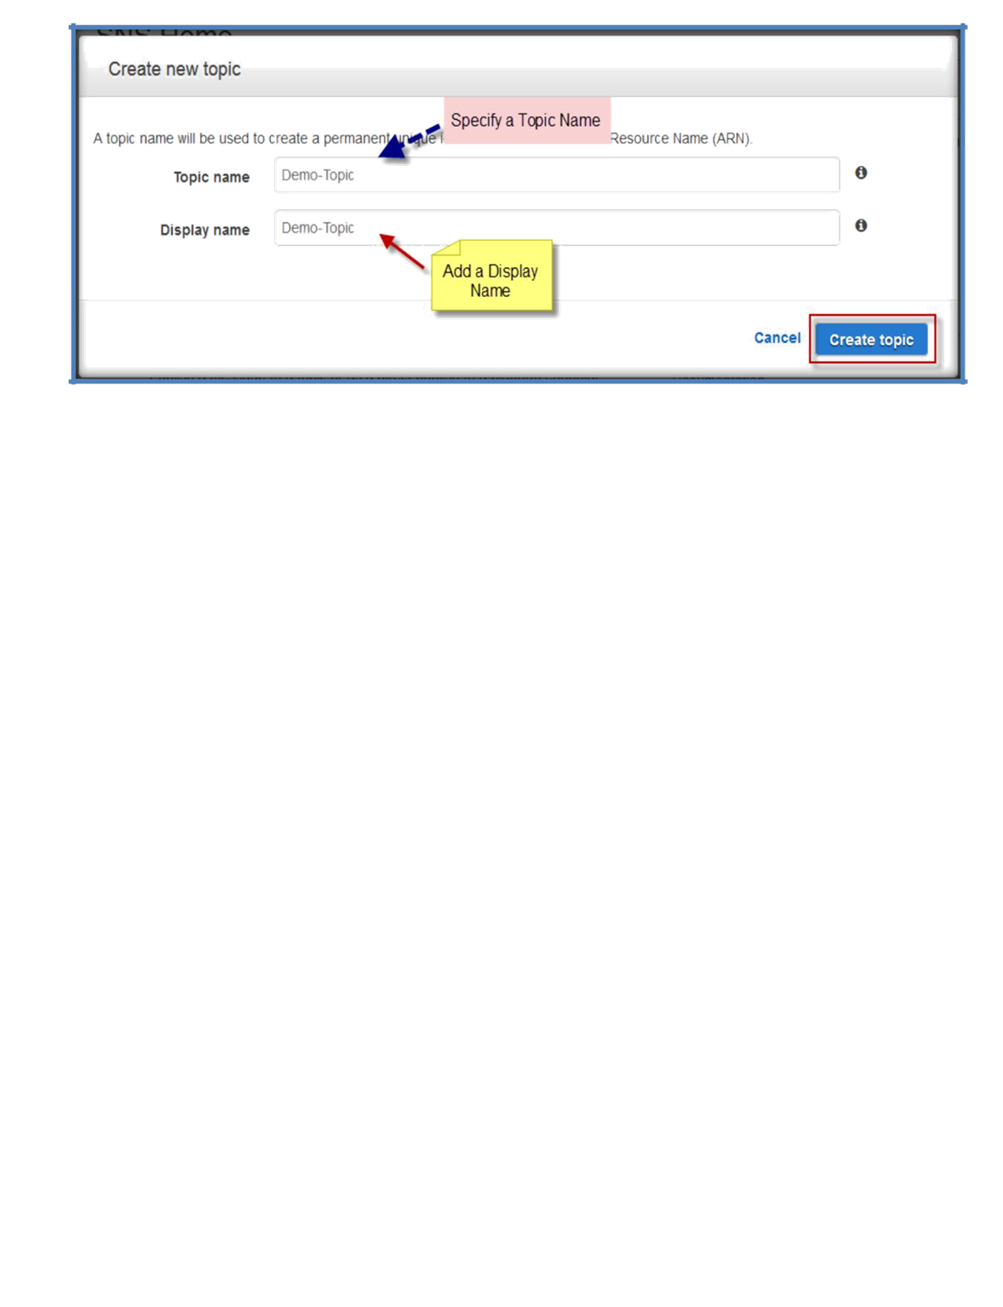
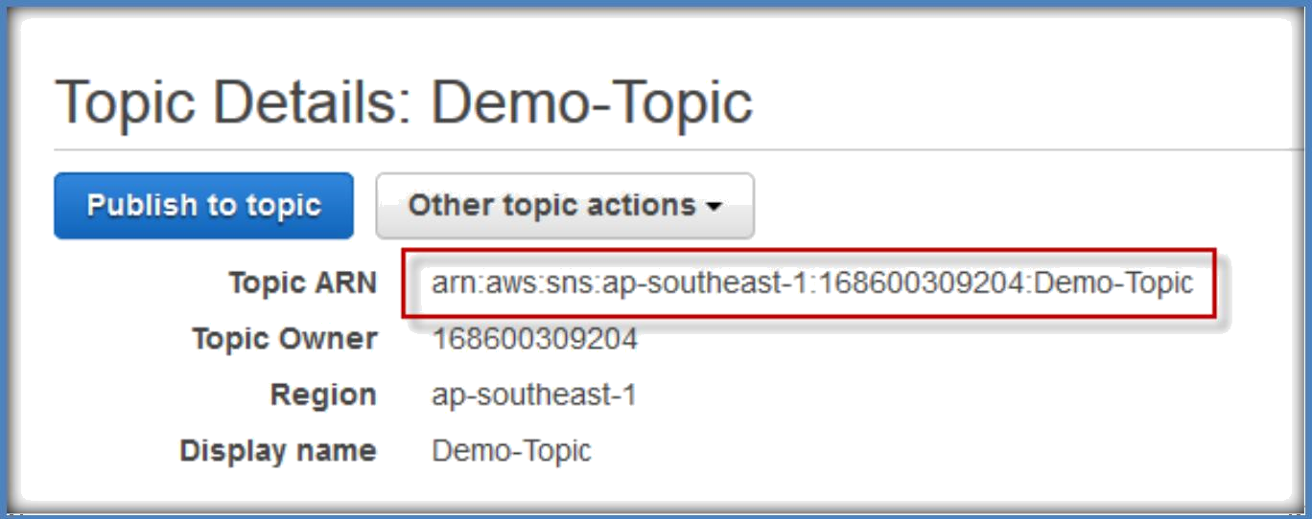
In the next page you can see a confirmation saying topic has successfully created.
With below showing options, copy the Topic ARN for next task.

Slide 4
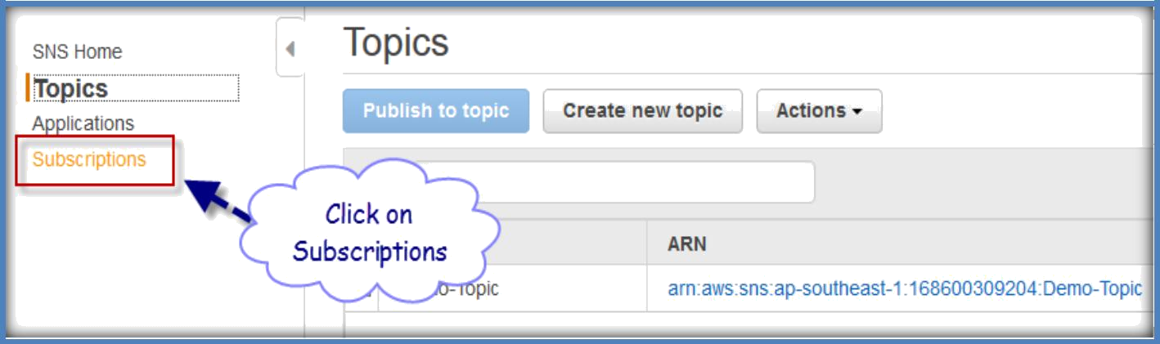
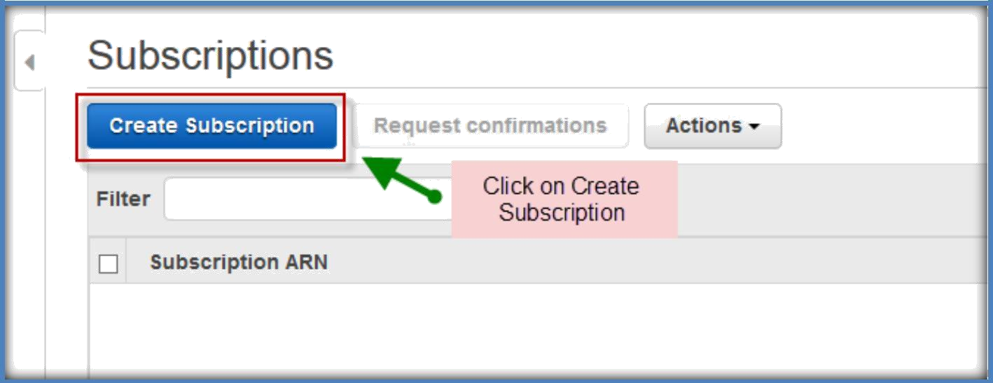
SUBSCRIBE TO A TOPIC
To receive messages published to a topic, you have to subscribe an endpoint to that topic.
An endpoint is a mobile app, web server, email address, or an Amazon SQS queue that can receive notification messages from Amazon SNS.
Once you subscribe an endpoint to a topic and the subscription is confirmed, the endpoint will receive all messages published to that topic.
In this section you subscribe an endpoint to the topic you just created in the previous section.
You configure the subscription to send the topic messages to your email account.
Go to SNS home page, Select Subscriptions from the left pane.
Once you are in the subscriptions page, click on Create Subscription to create a new one.

Slide 5
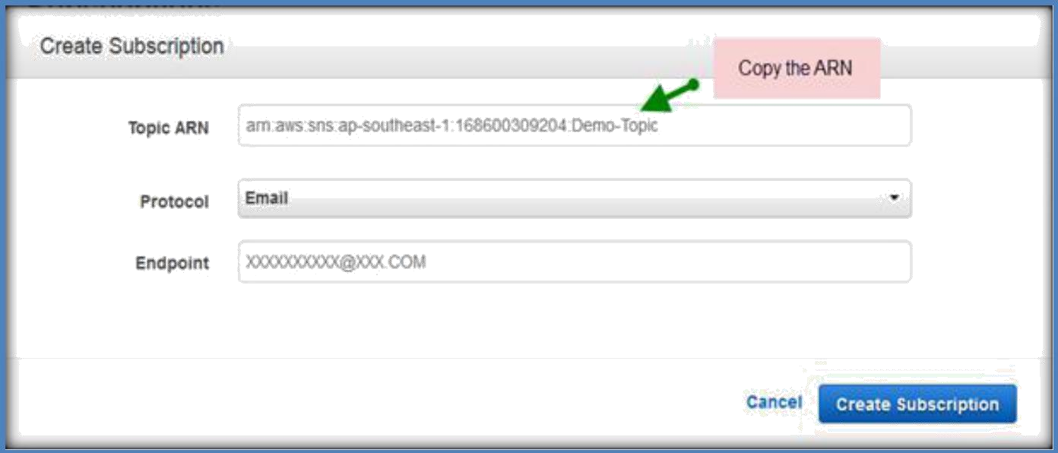
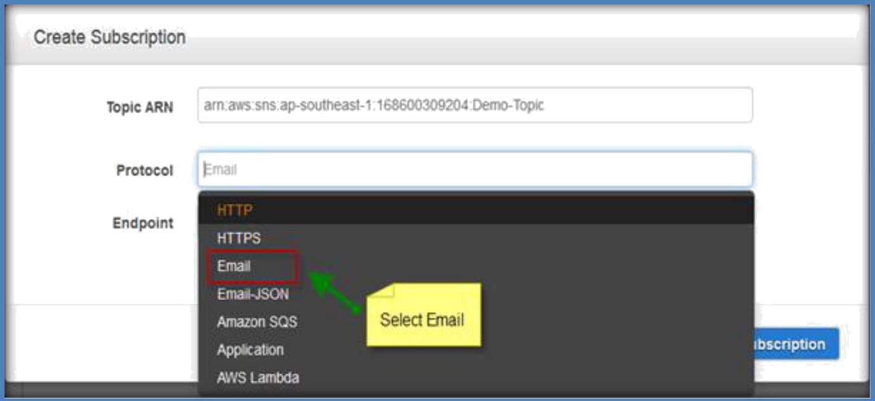
Paste the ARN which you have copied from newly created Topic in Topic ARN text filed.
Select Email from the Protocol drop down list.
Specify Email address in the Endpoint text field and click on Create Subscription.

Slide 6
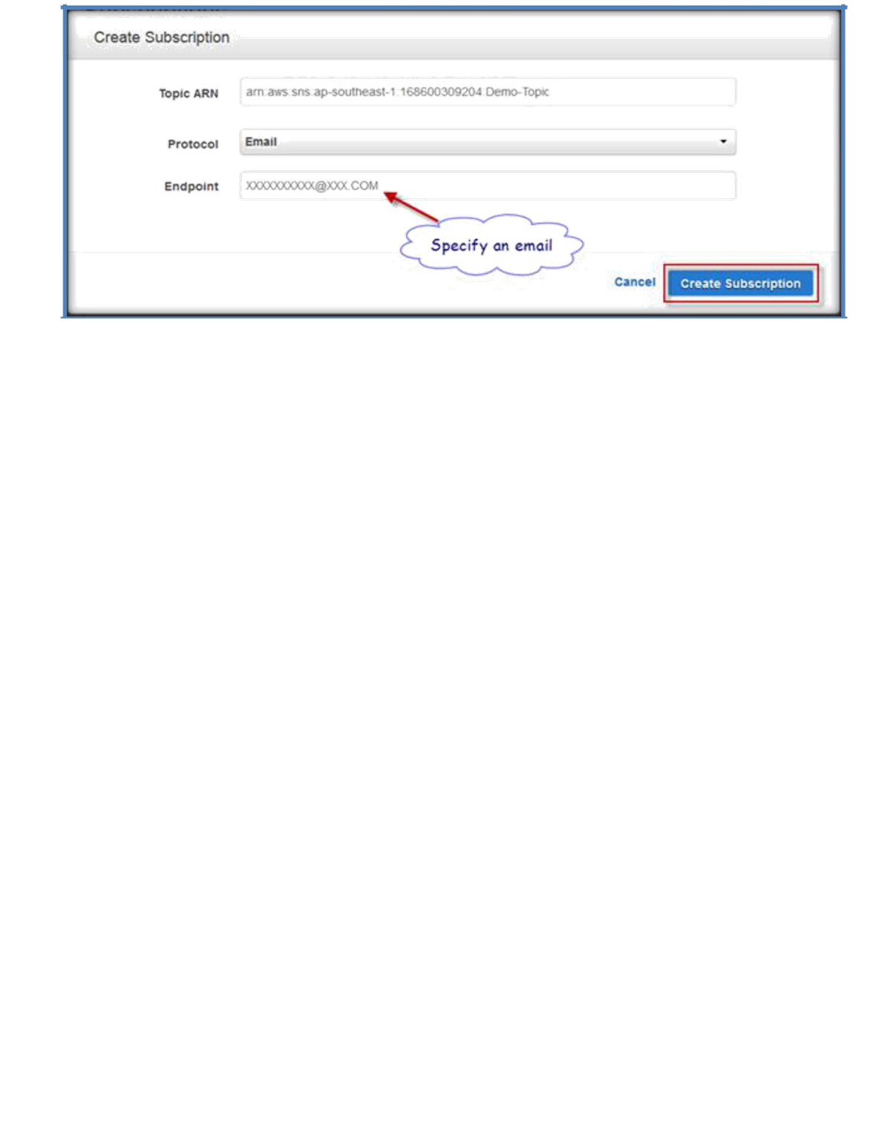
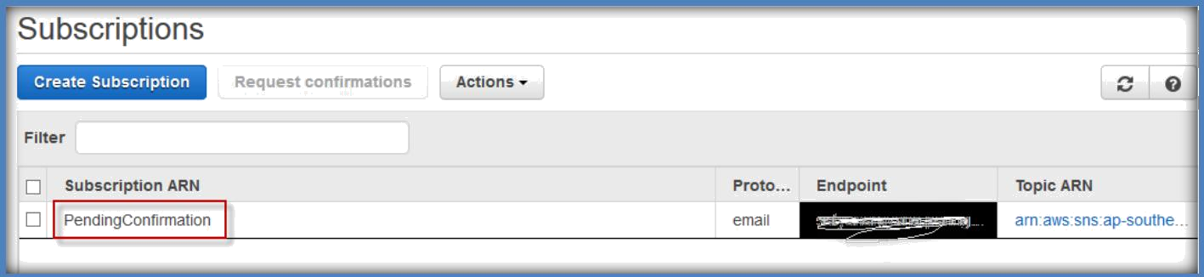
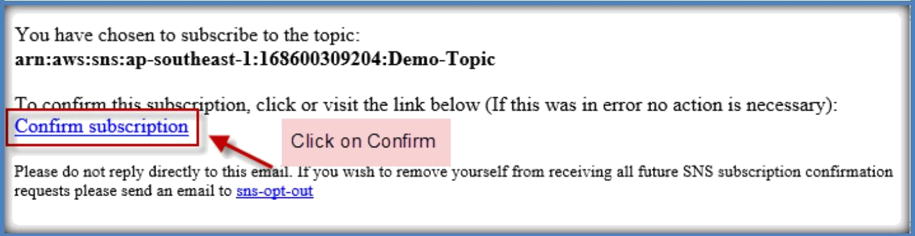
Once created, subscription is status is under Pending Confirmation.
You will receive an email for confirmation to the specified email address.
Go and check the email and confirm the subscription. After confirmation only you can be able to receive the email notifications.
Once you click on Confirm subscription, it will open a web page and displayed as Subscription confirmed.

Slide 7
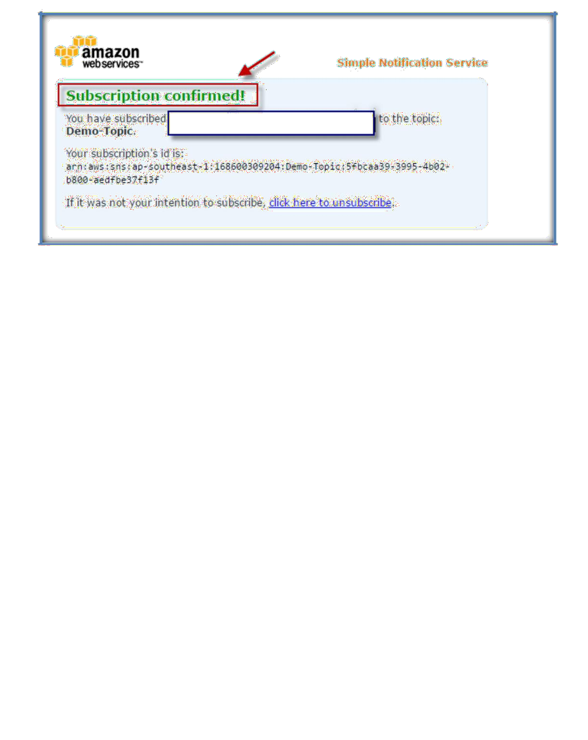
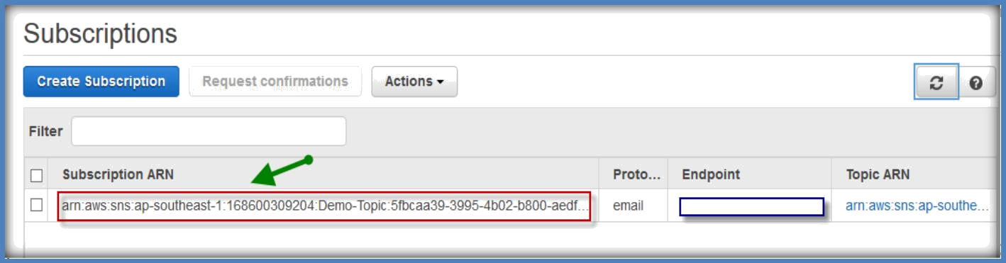
After confirmation, you can see the pending confirmation will vanish from the subscription page and will show topic ARN.
DELETING SUBSCRIPTION AND TOPIC

Slide 8
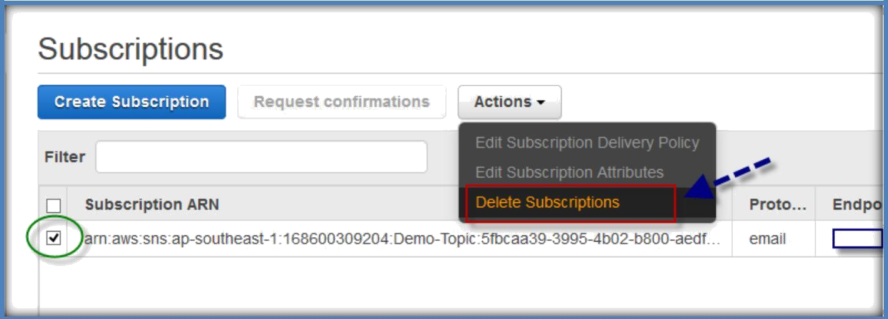
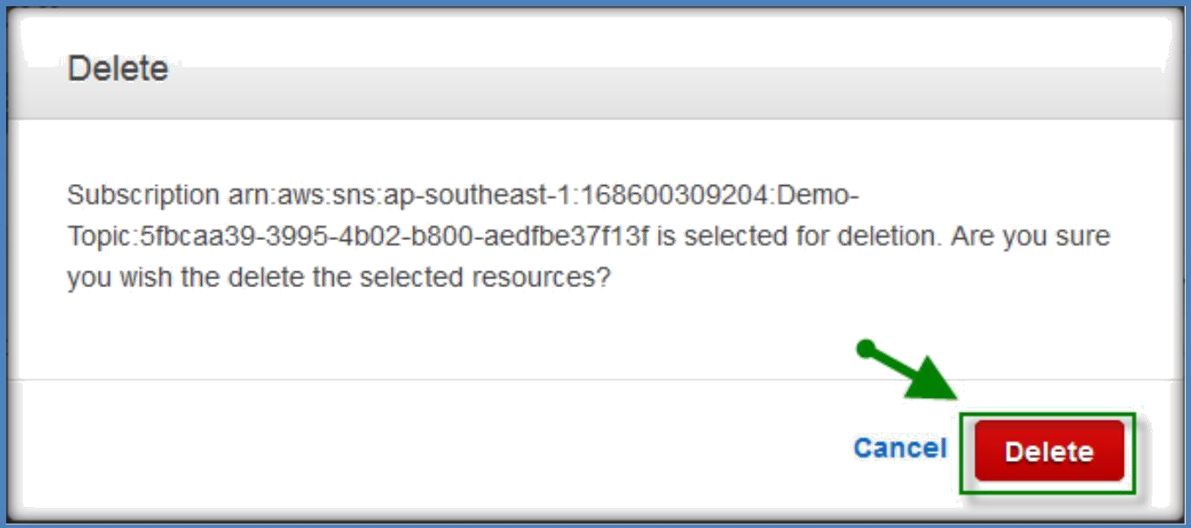
Go to subscription page under SNS page on AWS console.
Select subscription you want to delete and click on actions, under the actions select Delete Subscriptions.
In the next window, click on Delete to confirm the deletion.
Go to the topics tab under SNS home, select the topic and click on Actions. Under actions, select delete topics to delete the selected topic.

Slide 9
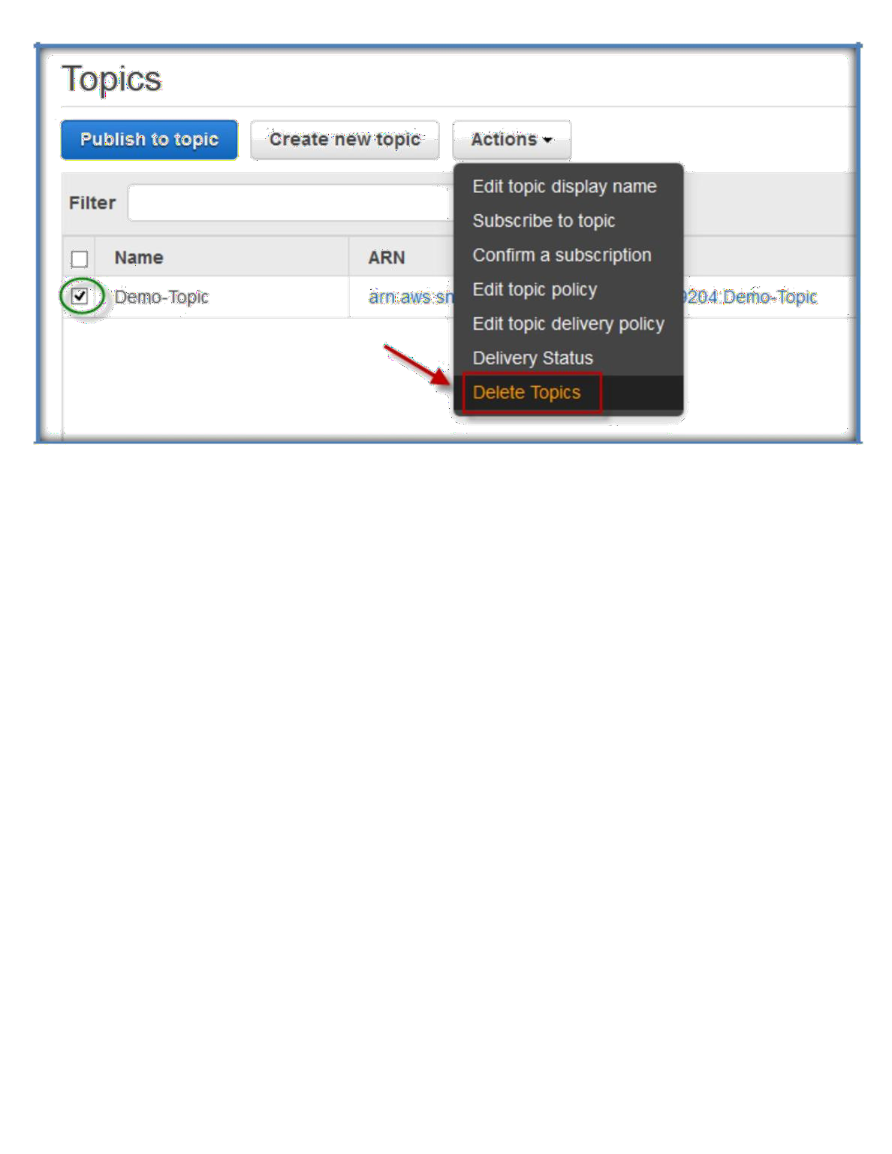
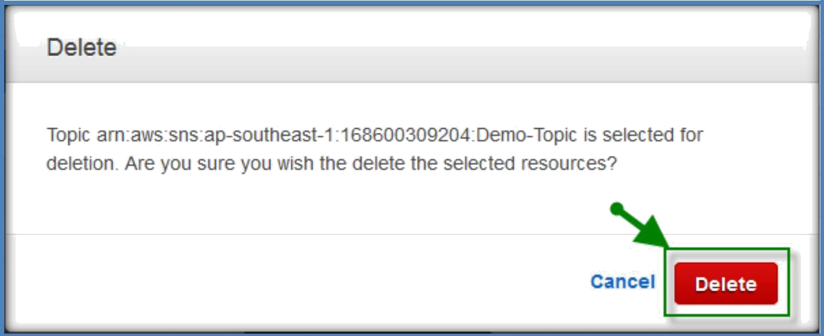
In the next window, click on Delete confirm the Topic deletion.

